Slide 1

Module 2-Big Data Algorithms
Relational Operations

Slide 2

BIG DATA ALGORITHMS
How can we perform relational algebraic operations for Big Data?
Overview of Relational Algebra
The relational algebra is a procedural query language.
It consists of a set of operations that take one or two relations as input and produce a new relation as their result.
The fundamental operations in the relational algebra are
Select
Project
Union, intersection, set difference
Cartesian product
Rename
Natural Join
Grouping
Aggregation

Slide 3
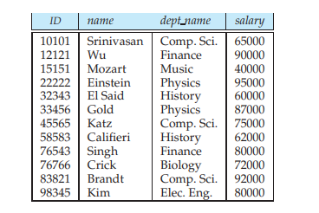

BIG DATA ALGORITHMS
How can we perform relational algebraic operations for Big Data?
Relational Algebra Operations
Selection: σ_{C} (R) select from R according to condition C
Find the tuples where the instructor is in the “Physics” department

Slide 4
BIG DATA ALGORITHMS
Issue with Big Data
10101,Srinivasan,Comp.Sci, 65000
12121,Wu,Finance,90000
15151,Mozart, Music, 40000
22222,Einstein, Physics, 95000
………..
Now how to perform the Query

Slide 5
BIG DATA ALGORITHMS
Selection with Map Reduce
Mapper
Read the CSV file contents row by row t
Check for the condition
If condition satisfies, store that as a key as well as a value. (t,t)
Reducer
Map Output:
<“22222, Einstein,Physics,95000”,”22222,Eistein,Physics,95000”>
Nothing Performed
Reduce Output:
<“22222, Einstein,Physics,95000”,”22222,Eistein,Physics,95000”>

Slide 6

BIG DATA ALGORITHMS
How can we perform relational algebraic operations for Big Data?
Relational Algebra Operations
Projection σ_{S} (R) select from R subset of attributes S
list all instructors’ ID, name, and salary

Slide 7
BIG DATA ALGORITHMS
Projection with Map Reduce
Mapper
Read the CSV file contents row by row t
Compute subset of attributes t’
Output (t’,t’)
Reducer
Map Output:
<“10101,Srinivasan, 65000”,” 10101,Srinivasan, 65000”>
Remove Duplicates
Reduce Output:
<“10101,Srinivasan, 65000”>

Slide 8
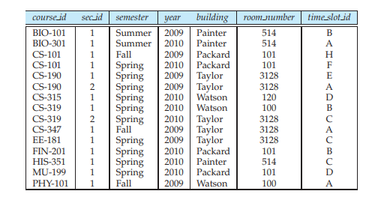

BIG DATA ALGORITHMS
Set Operations- Union
Find the set of all courses taught in the Fall 2009 semester, the Spring 2010 semester, or both.

Slide 9
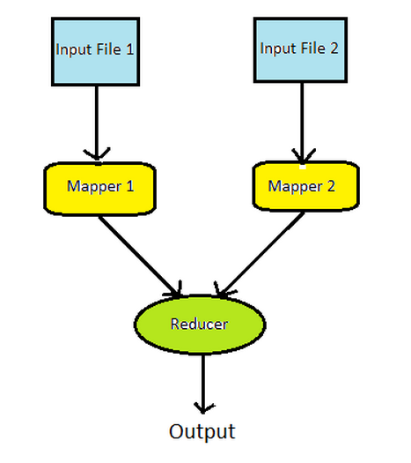
BIG DATA ALGORITHMS
Implementation in Map Reduce
Basic Problem
Need to read in 2 input files
produce 1 output file
Problem: multiple input files can be combined in many ways
We can have all the records of one file followed by all the records of another file
Or merge the two files and sort the records
Files may not have the same structure

Slide 10
BIG DATA ALGORITHMS
Union Implementation in Map Reduce
mapper 1
Read each row of table R
Output (t,t)
mapper 2
Read each row of table S
Output (t,t)
reducer
Eliminate duplicates if any
(t,[t,t]) -> (t,t)

Slide 11
BIG DATA ALGORITHMS
Sample Problem
Given the following input for two files
File 1
A
B
C
D
File 2
A
E
F
C
Show (for the Union algorithm)
Input and output of mapper 1
Input and output of mapper 2
Input and output of reducer

Slide 12
BIG DATA ALGORITHMS
Sample Problem
Mapper 1 output
A , A
B, B
C, C
D, D
Mapper 2 output
A, A
E, E
F, F
C, C
Reducer Input
A, [A, A]
B, B
C, [C, C]
D, D
E, E
F, F
Reducer Output
A
B
C
D
E
F

Slide 13

BIG DATA ALGORITHMS
Set Operations- Intersection
Find the set of all courses taught in the both Fall 2009 semester and Spring 2010 semester.

Slide 14
BIG DATA ALGORITHMS
Set Operations- Intersection
Compute R ∩ S
mapper 1
Read each row of table R
Output (t,t)
mapper 2
Read each row of table S
Output (t,t)
reducer
Output only duplicates
(t,[t,t]) -> (t,t)

Slide 15
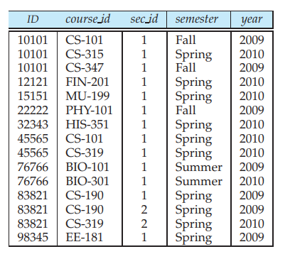
BIG DATA ALGORITHMS
Natural Join
The natural join is a binary operation that allows us to combine certain selections and a Cartesian product into one operation.
The natural-join operation forms a Cartesian product of its two arguments, performs a selection forcing equality on those attributes that appear in both relation schemas, and finally removes duplicate attributes.

Slide 16
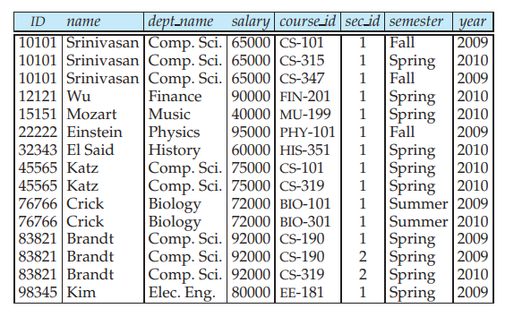
BIG DATA ALGORITHMS
Natural Join
Join R and S on attributes B
A, C are the other attributes in R,S
mapper 1
Read (a,b) of R, output (b,(R,a))
mapper 2
Read (b,c) of S, output (b,(S,c))
reducer
for each pair b,(R,a)) and (b,(S,c)), output (a,b.c)

Slide 17
C Problem lass Exercise(15 minutes)
BIG DATA
Given the following input for two files
Table Employee E(Name, age)
Gabbar 35
Viru 37
Jai 33
Baldev 44
Basanti 31
Table Dept D(Name, Dept)
Gabbar Bandit
Viru Hero
Jai Hero
Baldev Police
Basanti Heroine
Show (for the Natural Join algorithm)
Input and output of mapper 1
Input and output of mapper 2
Input and output of reducer

Slide 18
Solution
BIG DATA
Mapper 1 Output
Gabbar, (E, 35)
Viru, (E, 37)
Jai, (E, 33)
Baldev, (E, 44)
Basanti, (E, 31)
Mapper 2 Output
Gabbar, (D, Bandit)
Viru, (D, Hero)
Jai, (D, Hero)
Baldev (D, Police)
Basanti (D, Heroine)
Reducer Input
Gabbar, (E, 35), (D, Bandit)
Viru, (E, 37), (D, Hero)
Jai, (E, 33), (D, Hero)
Baldev, (E, 44), (D, Police)
Basanti, (E, 31), (D, Heroine)
Reducer Output
Gabbar, 35, Bandit
Viru, 37, Hero
Jai, 33, Hero
Baldev, 44, Police
Basanti, 31, Heroine)

Slide 19
...Grouping and Aggregation
BIG DATA
map
for each line (a,b,c) (e.g., User, Friend, Date)
Output (a,b) (e.g., User, Friend)
reduce
Aggregate (a, [b1 , b2 , b3 , ...]) into (a, f(b1 , b2 , b3 , ...))

Slide 20
Designing Real World Systems

Slide 21

Few points
Choosing Right
Cloudera’s alternative to Hive
Major advantage
Avoid start up costs
Parallel SQL engine on Hadoop
BI style queries
Cloudera consider using Impala instead of HIVE

Slide 22
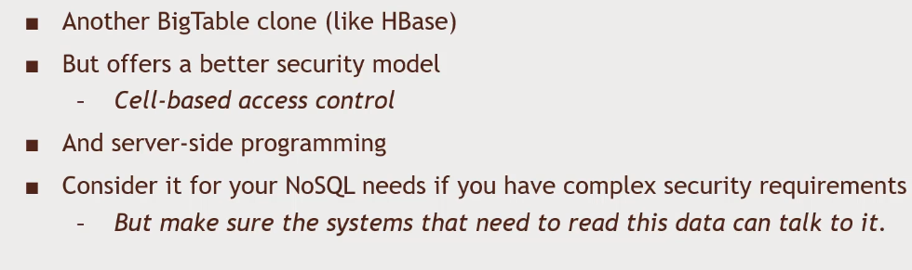

Few points
Choosing Right

Slide 23
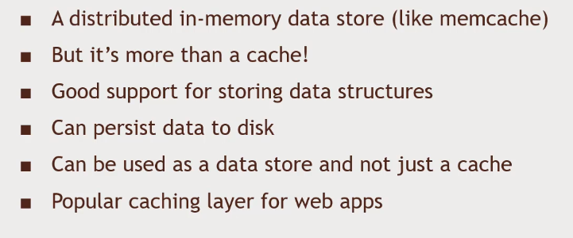

Few points
Choosing Right

Slide 24
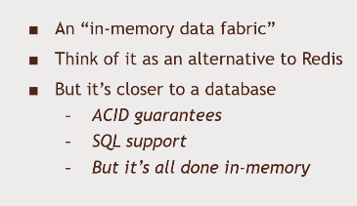

Few points
Choosing Right

Slide 25
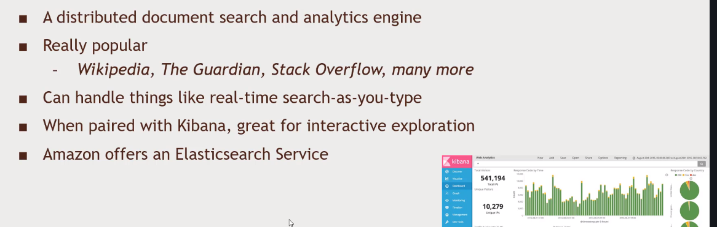
Few points
Choosing Right

Slide 26
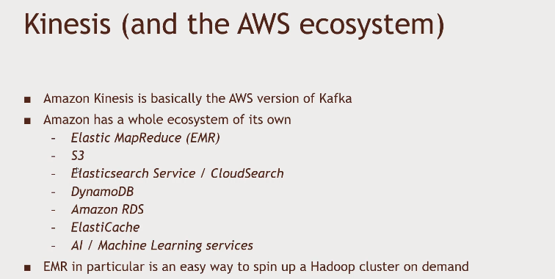
Few points
Choosing Right

Slide 27
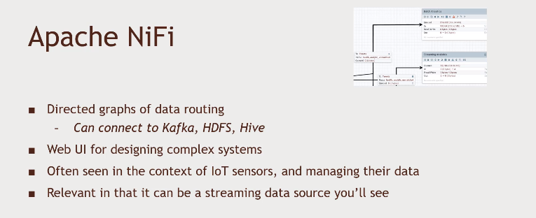
Few points
Choosing Right

Slide 28
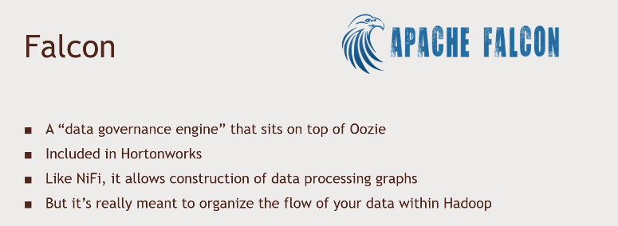
Few points
Choosing Right

Slide 29
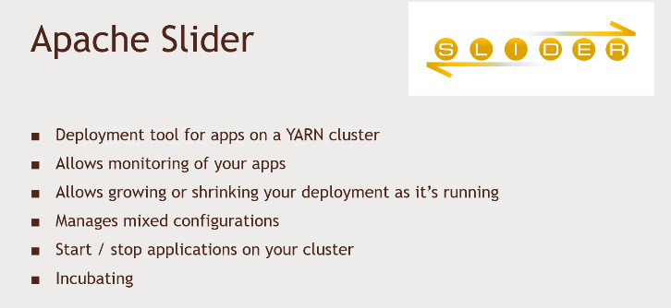
Few points
Choosing Right

Slide 30


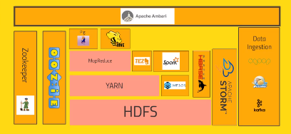




Assemble the technologies into larger system
How to fit them?

Slide 31
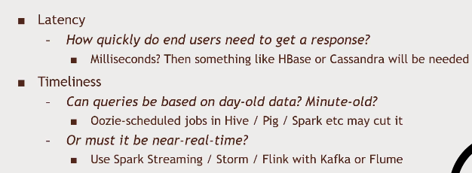
Understand the requirements
How to fit them?

Slide 32
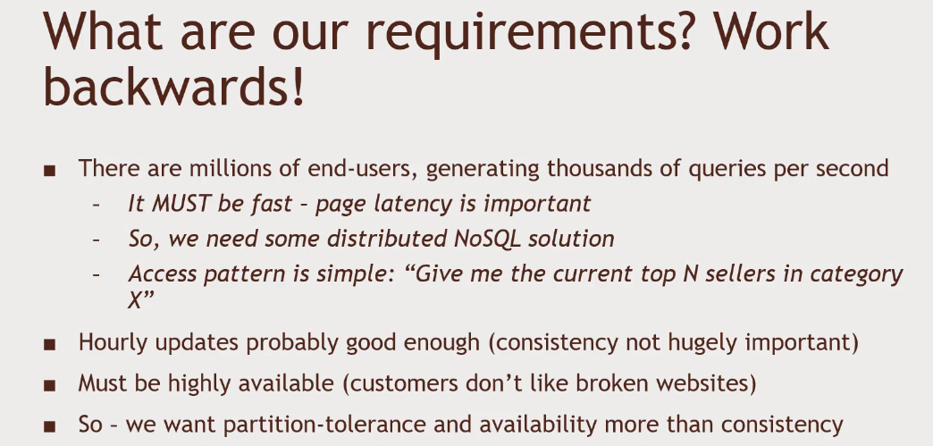
Design a system to keep track of Top-Selling Items
First Example

Slide 33
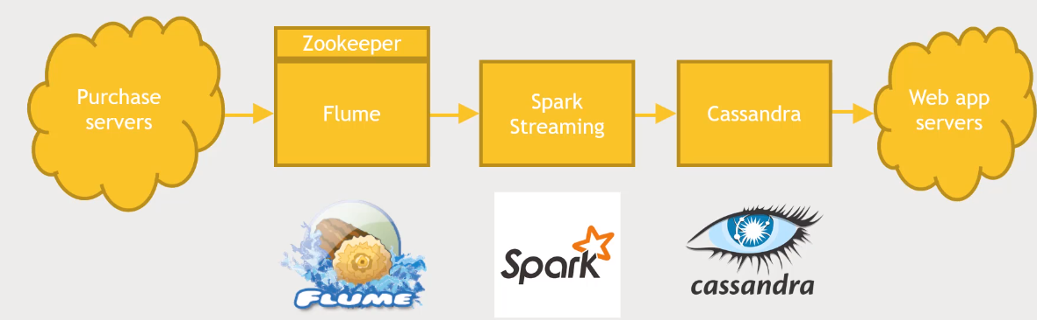
Design a system to keep track of Top-Selling Items
First Example

Slide 34
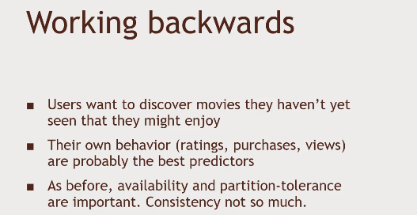
Movie recommendations to a Website
Second Example

Slide 35
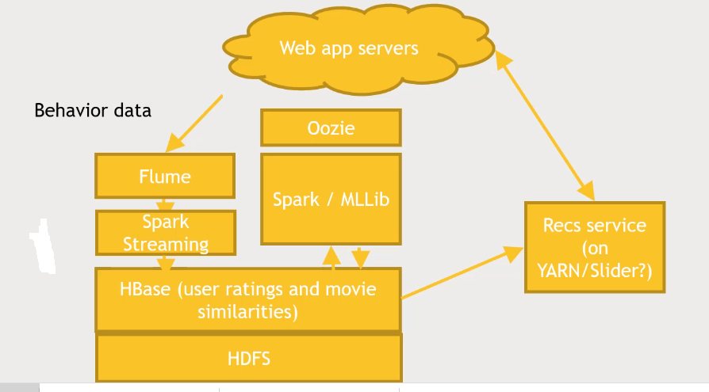
Movie recommendations to a Website
First Example

Slide 36
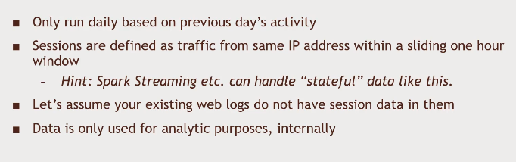
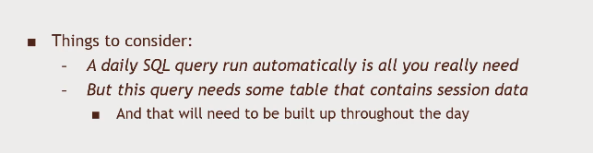
Track the number of sessions per day on a website
Third Example

Slide 37
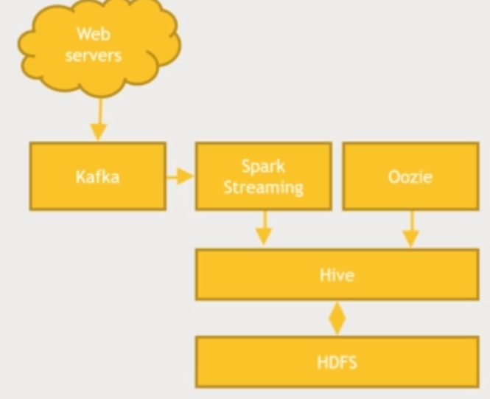
Track the number of sessions per day on a website
Third Example

Slide 38
THANK YOU

